Slide 1

Flipkart Customer Segmentation & Targeted Marketing Intelligence
By Nahid Bilal Sayyed

Slide 2
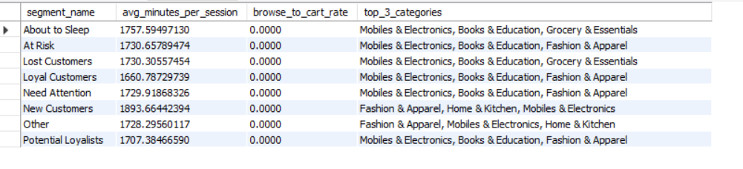
Behavioural Study of Each Segment:
Mobiles & Electronics and Books & Education are the primary interests for the majority of segments (At Risk, About to Sleep, Potential Loyalists).
Fashion & Apparel is a secondary driver, particularly for New Customers and Loyalists.
All segments show extremely high session durations, ranging from 1,660 to 1,893 minutes.
There is a 0.00% Browse-to-Cart rate across every single segment. While users are spending significant time on the platform

Slide 3
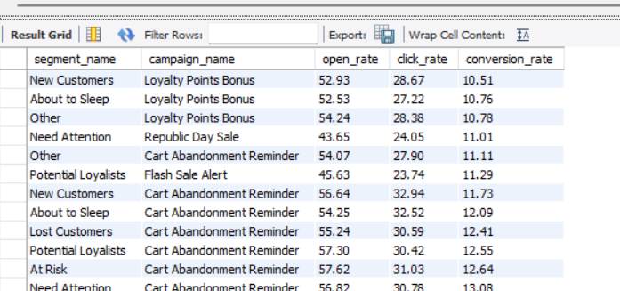
Campaign Performance:

Slide 4
Top 3 Best Performing Campaigns:
The Conversion Winner: The Cart Abandonment Reminder is the undisputed champion. It achieved the highest conversion rate in the dataset (14.32% for Loyal Customers). This suggests that users are highly intent-driven but need a final nudge to cross the 0% cart-to-browse gap noted in your session data.
The Attention Winner: The Re-engagement Coupon consistently sees the highest Open Rates (peaking at 63.78%). While its conversion is lower (~7%), it is your most effective tool for getting "Lost" or "At Risk" customers to actually open their emails.
The Underperformer: Big Billion Days Teaser and Premium Brand Launch show the lowest conversion rates (often <5%). These function better as "Awareness" tools rather than "Direct Response" tools.
Segment Synergy: The Republic Day Sale performed exceptionally well for the Need Attention segment (11.01% conversion), suggesting that holiday-themed urgency works best on mid-tier, fading customers.
Campaign Name | Avg. Conversion Rate | Primary Strength | Best For...
Cart Abandonment Reminder | 11.1% – 14.3% | Highest Conversion | Closing sales for "Loyal" and "At Risk" segments.
Flash Sale Alert | 9.0% – 11.3% | High Click-Through | Driving immediate traffic and clearing inventory.
Loyalty Points Bonus | 8.1% – 10.8% | Balanced Engagement | Maintaining long-term retention across all segments.

Slide 5
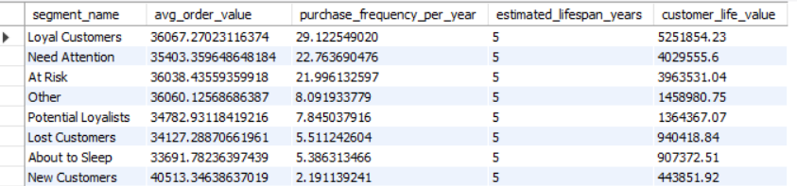
Customer Life Value for each Segment:

Slide 6
Market recommendations for each segment
Segment | Primary Channel | Offer Type | Product Category | Discount Depth | Data-Driven Justification
Champions | Email (VIP branded) | Early Access | New Arrivals / Premium | 0% | Their high M and F scores show they value status and exclusivity over price cuts.
Loyal Customers | In-App | Loyalty Points | Frequently Bought | 0% (2x Points) | High F scores suggest habitual use; points increase switching costs to competitors.
Potential Loyalists | Push Notification | Bundle Offer | Complementary Items | 10% | Their high R but low M/F suggests they are testing you; bundles increase Average Order Value (AOV).
New Customers | Email | Welcome Coupon | Best Sellers | 15% | High R and F=1 means they are in the "honeymoon" phase; a discount secures the critical second purchase.

Slide 7
Promising | In-App | Loyalty Points | Trending Items | 0% (Bonus) | Recent engagement with low history suggests they need a "nudge" to join your ecosystem.
Need Attention | SMS | Percentage Discount | Last Browsed Category | 20% | Mid-tier R/F scores indicate they are starting to drift; a direct SMS with a clear discount regains focus.
About to Sleep | Push Notification | Percentage Discount | High-Rated Staples | 25% | Low R and F scores show fading interest; a higher discount is needed to disrupt their exit.
At Risk | Email | Win-back Coupon | Personalized Recomm. | 30% | These were high-value (F/M 2-5) but haven't bought recently; aggressive saving is cheaper than acquisition.
Cannot Lose Them | SMS | Win-back Coupon | Brand Favorites | 40% | R=1 with high F/M means they’ve likely switched brands; a "heavy" offer is the only way to get a reappraisal.
Lost Customers | Email | Win-back Coupon | Clearance / Outlet | 50% | Low scores across the board; use deep discounts only to clear stock or gain survey data.

Slide 8
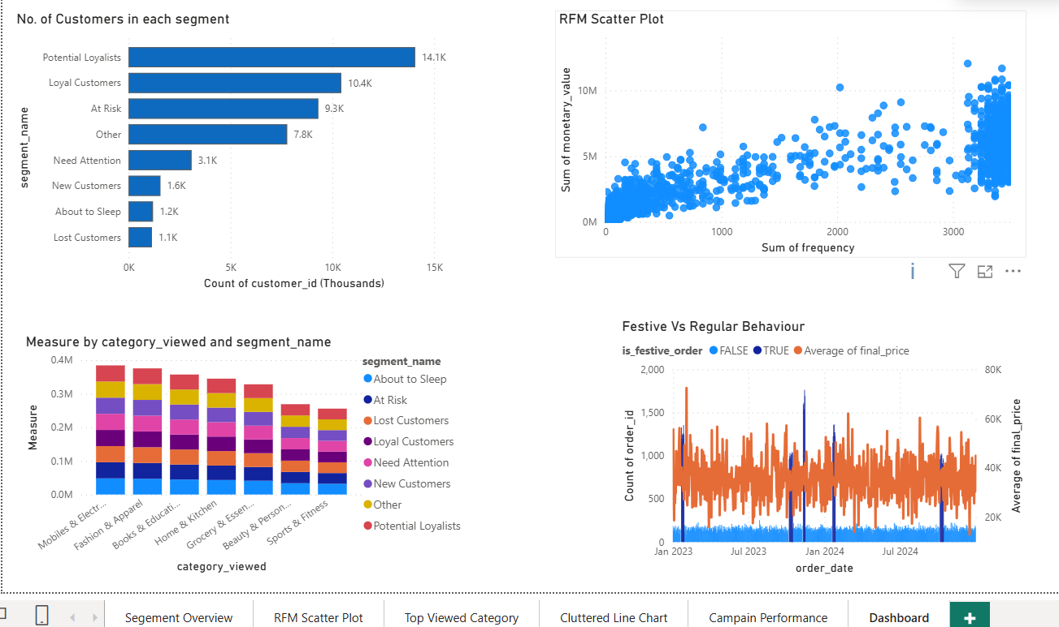
Visual Presentation in Power BI:

Slide 9
THANK YOU!
Nahid Bilal Sayyed

